Slide 1

Asynchronous Programming and Promises
Fetch API, Promises, async/await
SoftUni Team
Technical Trainers
Software University
https://softuni.bg

Slide 2
Table of Contents
AJAX
Asynchronous Programming
Promises Deep Dive
Async / Await

Slide 3
Have a Question?
sli.do #js-advanced

Slide 4
AJAX
A AX
Asynchronous JavaScript and XML

Slide 5
What is AJAX?
Asynchronous JavaScript And XML
Background loading of dynamic content/data
Load data from the Web server and render it
Some examples of AJAX usage:
Partial page rendering
Load HTML fragment + show it in a <div>
JSON service
Loads JSON object and displays it

Slide 6


AJAX: Workflow
Client
Web Server
HTTP request (initial page load)
Browser
Static
HTTP response (HTML page)
JS App
REST

Slide 7
AJAX: Workflow
Client
Web Server
Browser
Static
JS App
AJAX request
UI Interaction
REST
AJAX handler
Returns data as JSON

Slide 8

Using the XMLHttpRequest Object
AJAX request
AJAX response
Web Client
Web Server

Slide 9
XMLHttpRequest – Standard API for AJAX
<button id = "load">Load Repos</button>
<div id="res"></div>
let button = document.querySelector("#load");
button.addEventListener('click', function loadRepos() {
let url = 'https://api.github.com/users/testnakov/repos';
const httpRequest = new XMLHttpRequest();
httpRequest.addEventListener('readystatechange', function () {
if (httpRequest.readyState == 4 && httpRequest.status == 200) {
document.getElementById("res").textContent = httpRequest.responseText;
}
});
httpRequest.open("GET", url);
httpRequest.send();
});
Notes:
Check this slides code -> I think it can be optimized

Slide 10

Synchronous vs Asynchronous
Asynchronous Programming

Slide 11
Asynchronous Programming in JS
Structured using callback functions
In current versions of JS there are:
Callbacks
Promises
Async Functions
Not the same thing as concurrent or multi-threaded
JS code is generally single-threaded

Slide 12
Asynchronous Programming
Runs several tasks (pieces of code) in parallel, at the same time
Synchronous
Asynchronous
Number of tasks
Number of tasks
1
1
20 seconds
20 seconds
2
2
7 seconds
7 seconds
3
3
10 seconds
10 seconds
4
4
8 seconds
8 seconds

Slide 13
Asynchronous Programming – Example
The following commands will be executed as follows:
console.log("Hello.");
setTimeout(function() {
console.log("Goodbye!");
}, 2000);
console.log("Hello again!");
// Hello.
// Hello again!
// Goodbye!

Slide 14
Callbacks
Function passed into another function as an argument
Then invoked inside the outer function to complete some kind of routine or action
function running() {
return "Running";
}
function category(run, type) {
console.log(run() + " " + type);
}
category(running, "sprint"); //Running sprint
Callback
function

Slide 15
Event Loop Synchronization
Execution Stack
Browser APIs
APIs operate asynchronously
Event loop is paused during execution
Code executing on the main thread
Event Loop
Event Queue
Callbacks wait in the queue

Slide 16
Event Loop Synchronization
Execution Stack
Browser APIs
Function
Function call
API Call
Callback
Event Loop
Function
Event Queue
Paused
Function
Program starting

Slide 17
Event Loop Synchronization
Execution Stack
Browser APIs
Function
API Call
Callback
Event Loop
Function
Event Queue
Paused
Function

Slide 18


Event Loop Synchronization
API working in background
Execution Stack
Browser APIs
API Call
Callback
Function
Event Loop
Function
Event Queue
Paused
Function

Slide 19
Event Loop Synchronization
Execution Stack
Browser APIs
API Call
Callback
Code continues execution
Function
Event Loop
Function
Event Queue
Paused
Function

Slide 20
Event Loop Synchronization
Execution Stack
Browser APIs
More API calls
Function
API Call
Callback
API Call
Callback
API Call
Callback
Function
Event Loop
Function
Event Queue
Paused
Function

Slide 21
Event Loop Synchronization
Execution Stack
Browser APIs
Function
API Call
Callback
API Call
Callback
API Call
Callback
Function
Event Loop
Function
Event Queue
Paused
Function

Slide 22
Event Loop Synchronization
Operations may complete out of order
(asynchronously)
Execution Stack
Browser APIs
Function
API Call
Callback
API Call
Callback
API Call
Callback
Function
Event Loop
Function
Event Queue
Paused
Function

Slide 23
Event Loop Synchronization
Execution Stack
Browser APIs
Function
Code execution must complete to unblock the Event Loop
Function
Event Loop
Function
Event Queue
Paused
Function
Callback
Callback
Callback

Slide 24
Event Loop Synchronization
Execution Stack
Browser APIs
Function
Code execution must complete to unblock the Event Loop
Function
Event Loop
Function
Event Queue
Paused
Function
Callback
Callback
Callback

Slide 25
Event Loop Synchronization
Execution Stack
Browser APIs
Idle
Main thread is idle
Event Loop
Paused
Event Queue
Callback
Callback
Callback

Slide 26
Event Loop Synchronization
Execution Stack
Browser APIs
Event Loop checks for events in the queue
Idle
Event Loop
Event Queue
Callback
Callback
Callback

Slide 27
Event Loop Synchronization
Execution Stack
Browser APIs
Event Loop checks for events in the queue
Idle
Event Loop
Event Queue
Callback
Callback
Callback

Slide 28
Event Loop Synchronization
Execution Stack
Browser APIs
Callback execution pauses Event Loop
Idle
Event Loop
Event Queue
Callback
Callback
Callback

Slide 29
Event Loop Synchronization
Execution Stack
Browser APIs
Idle
Event Loop
Event Queue
Callback
Callback
Callback

Slide 30
Event Loop Synchronization
Execution Stack
Browser APIs
Event Loop
Paused
Event Queue
Callback
Callback
Callback

Slide 31
Event Loop Synchronization
Execution Stack
Browser APIs
Execution Stack
Idle
Event Loop
Event Queue
Paused
Event Queue
Callback
Callback

Slide 32
Event Loop Synchronization
Execution Stack
Browser APIs
Execution Stack
Idle
Event Loop
Event Queue
Paused
Event Queue
Callback

Slide 33
Event Loop Synchronization
Execution Stack
Browser APIs
Idle
Waiting for events
Event Loop
Event Queue

Slide 34

Promises
Objects Holding Asynchronous Operations

Slide 35
What is a Promise?
A promise is an asynchronous action that may complete at some point and produce a value
States:
Pending - operation still running (unfinished)
Fulfilled - operation finished (the result is available)
Failed - operation failed (an error is present)
Promises use the Promise class
new Promise(executor);

Slide 36
Promise Flowchart
Promise resolves with data or throws error
Constructor takes Executor function as parameter
return data
throw error
Promise
Executor
resolve
reject
Success callback
then
Error callback
catch

Slide 37
Promise.then() – Example
console.log('Before promise');
new Promise(function(resolve, reject) {
setTimeout(function() {
resolve('done');
}, 500);
})
.then(function(res) {
console.log('Then returned: ' + res);
});
// Before promise
Resolved after 500 ms
// After promise
// Then returned: done
console.log('After promise');

Slide 38
Promise.catch() – Example
console.log('Before promise');
new Promise(function (resolve, reject) {
setTimeout(function () {
reject('fail');
}, 500);
})
.then (function (result) { console.log(result); })
.catch (function(error) { console.log(error); });
Rejected after 500 ms
console.log('After promise');

Slide 39
Promise Methods
Promise.reject(reason)
Returns an object that is rejected with the given reason
Promise.resolve(value)
Returns an object that is resolved with the given value
Promise.all(iterable)
Returns a promise
Fulfills when all of the promises have fulfilled
Rejects as soon as one of them rejects

Slide 40
Promise Methods (2)
Promise.allSettled(iterable)
Wait until all promises have settled
Promise.race(iterable)
Returns a promise that fulfills or rejects as soon as one of the promises in an iterable is settled
Promise.prototype.finally()
The handler is called when the promise is settled

Slide 41
What is Fetch?
The fetch() method allows making network requests
It is similar to XMLHttpRequest (XHR). The main difference is that the Fetch API:
Uses Promises
Enables a simpler and cleaner API
Makes code more readable and maintainable
fetch('./api/some.json')
.then(function(response) {…})
.catch(function(err) {…})

Slide 42
Basic Fetch Request
The response of a fetch() request is a Stream object
The reading of the stream happens asynchronously
When the json() method is called, a Promise is returned
The response status is checked (should be 200) before parsing the response as JSON
if (response.status !== 200) {
// handle error
}
response.json()
.then(function(data) { console.log(data)})

Slide 43
GET Request
Fetch API uses the GET method so that a direct call would be like this
fetch('https://api.github.com/users/testnakov/repos')
.then((response) => response.json())
.then((data) => console.log (data))
.catch((error) => console.error(error))

Slide 44
POST Request
To make a POST request, we can set the method and body parameters in the fetch() options
fetch('/url', {
method: 'post',
headers: { 'Content-type': 'application/json' },
body: JSON.stringify(data),
})

Slide 45
Body Methods
clone() create a clone of the response
json() resolves the promise with JSON
redirect() create new promise but with different URL
text() resolves the promise with string
arrayBuffer() resolve body with ArrayBuffer
blob() resolve body with Blob (file, image, etc.)
formData() resolve body with FormData

Slide 46
Response Types
basic - normal, same origin response
cors - response was received from a valid cross-origin request
error - error network
opaque - Response for "no-cors" request to cross-origin resource
opaqueredirect - the fetch request was made with redirect: "manual"

Slide 47
Chaining Promises
When working with a JSON API, you can:
Define the status and JSON parsing in separate functions
The functions return promises which can be chained
fetch('users.json')
.then(status)
.then(json)
.then(function(data) {…})
.catch(function(error) {…});

Slide 48
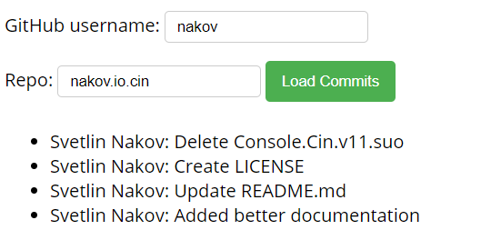
Problem: Load GitHub Commits
GitHub username:
<input type="text" id="username" value="nakov" /> <br>
Repo: <input type="text" id="repo" value="nakov.io.cin" />
<button onclick="loadCommits()">Load Commits</button>
<ul id="commits"></ul>
<script>
function loadCommits() {
// Use Fetch API
}
</script>

Slide 49
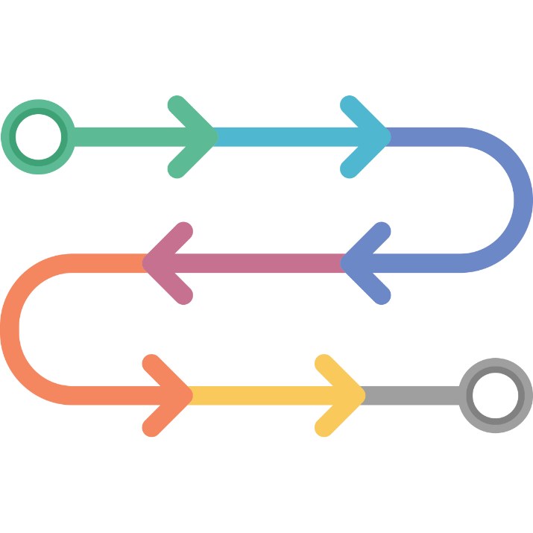
Async / Await
Simplified Promises

Slide 50
Async Functions
Returns a promise, that can await other promises in a way that looks synchronous
Operate asynchronously via the event loop
Contains an await expression that:
Is only valid inside async functions
Pauses the execution of that function
Waits for the Promise's resolution

Slide 51
Async Functions (2)
function resolveAfter2Seconds() {
return new Promise(resolve => {
setTimeout(() => {
resolve('resolved');
}, 2000);
});
}
Expected output:
// calling
// resolved
async function asyncCall() {
console.log('calling');
let result = await resolveAfter2Seconds();
console.log(result);
}

Slide 52
Async Functions (3)
Do not confuse await with Promise.then()
await is always used for a single promise
To await two or more promises in parallel, use Promise.all()
If a promise resolves normally, then await promise returns the result
In case of a rejection, it throws an error

Slide 53
Async/Await vs Promise.then
Promise.then
Async/Await
function logFetch(url) {
return fetch(url)
.then(response => {
return response.text()
})
.then(text => {
console.log(text);
})
.catch(err => {
console.error(err);
});
}
async function logFetch(url) {
try {
const response =
await fetch(url);
console.log(
await response.text()
);
}
catch (err) {
console.log(err);
}
}

Slide 54
Error Handling
async function f() {
try {
let response = await fetch();
let user = await response.json();
} catch (err) {
// catches errors both in fetch andresponse.json
alert(err);
}}
async function f() {
let response = await fetch();
} // f() becomes a rejected promise
f().catch(alert);

Slide 55
Sequential Execution
To execute different promise methods one by one, use Async /Await
function execute(x,sec) {
return new Promise(resolve => {
console.log('Start: ' + x);
setTimeout(() => {
console.log('End: ' + x);
resolve(x);
}, sec *1000); }); }
// Start: 1
// End: 1
// Start: 2
// End: 2
// Start: 3
// End: 3
// 6
async function serialFlow() {
let result1 = await execute(1, 1);
let result2 = await execute(2, 2);
let result3 = await execute(3, 3);
let finalResult = result1 + result2 + result3;
console.log(finalResult);
}

Slide 56
Concurrent Execution
async function parallelFlow() {
let result1 = execute(1,1);
let result2 = execute(2,2);
let result3 = execute(3,3);
let finalResult = await result1 + await result2 +
await result3;
console.log(finalResult);
}
// Expected output:
// Start: 1
// Start: 2
// Start: 3
// End: 1
// End: 2
// End: 3
// 6

Slide 57

Summary
…
…
…
Asynchronous programming
Runs several tasks in parallel, at the same time
Promises hold operations
Can be resolved or rejected
Async functions contain an await expression
Yields the execution
Waits for the Promise's resolution

Slide 58
Questions?
Notes:
58

Slide 59














SoftUni Diamond Partners

Slide 60

Educational Partners

Slide 61
Trainings @ Software University (SoftUni)
Software University – High-Quality Education, Profession and Job for Software Developers
softuni.bg, softuni.org
Software University Foundation
softuni.foundation
Software University @ Facebook
facebook.com/SoftwareUniversity
Software University Forums
forum.softuni.bg
Notes:
61

Slide 62

License
This course (slides, examples, demos, exercises, homework, documents, videos and other assets) is copyrighted content
Unauthorized copy, reproduction or use is illegal
© SoftUni – https://softuni.org
© Software University – https://softuni.bg
Notes:
62

